Slide 1
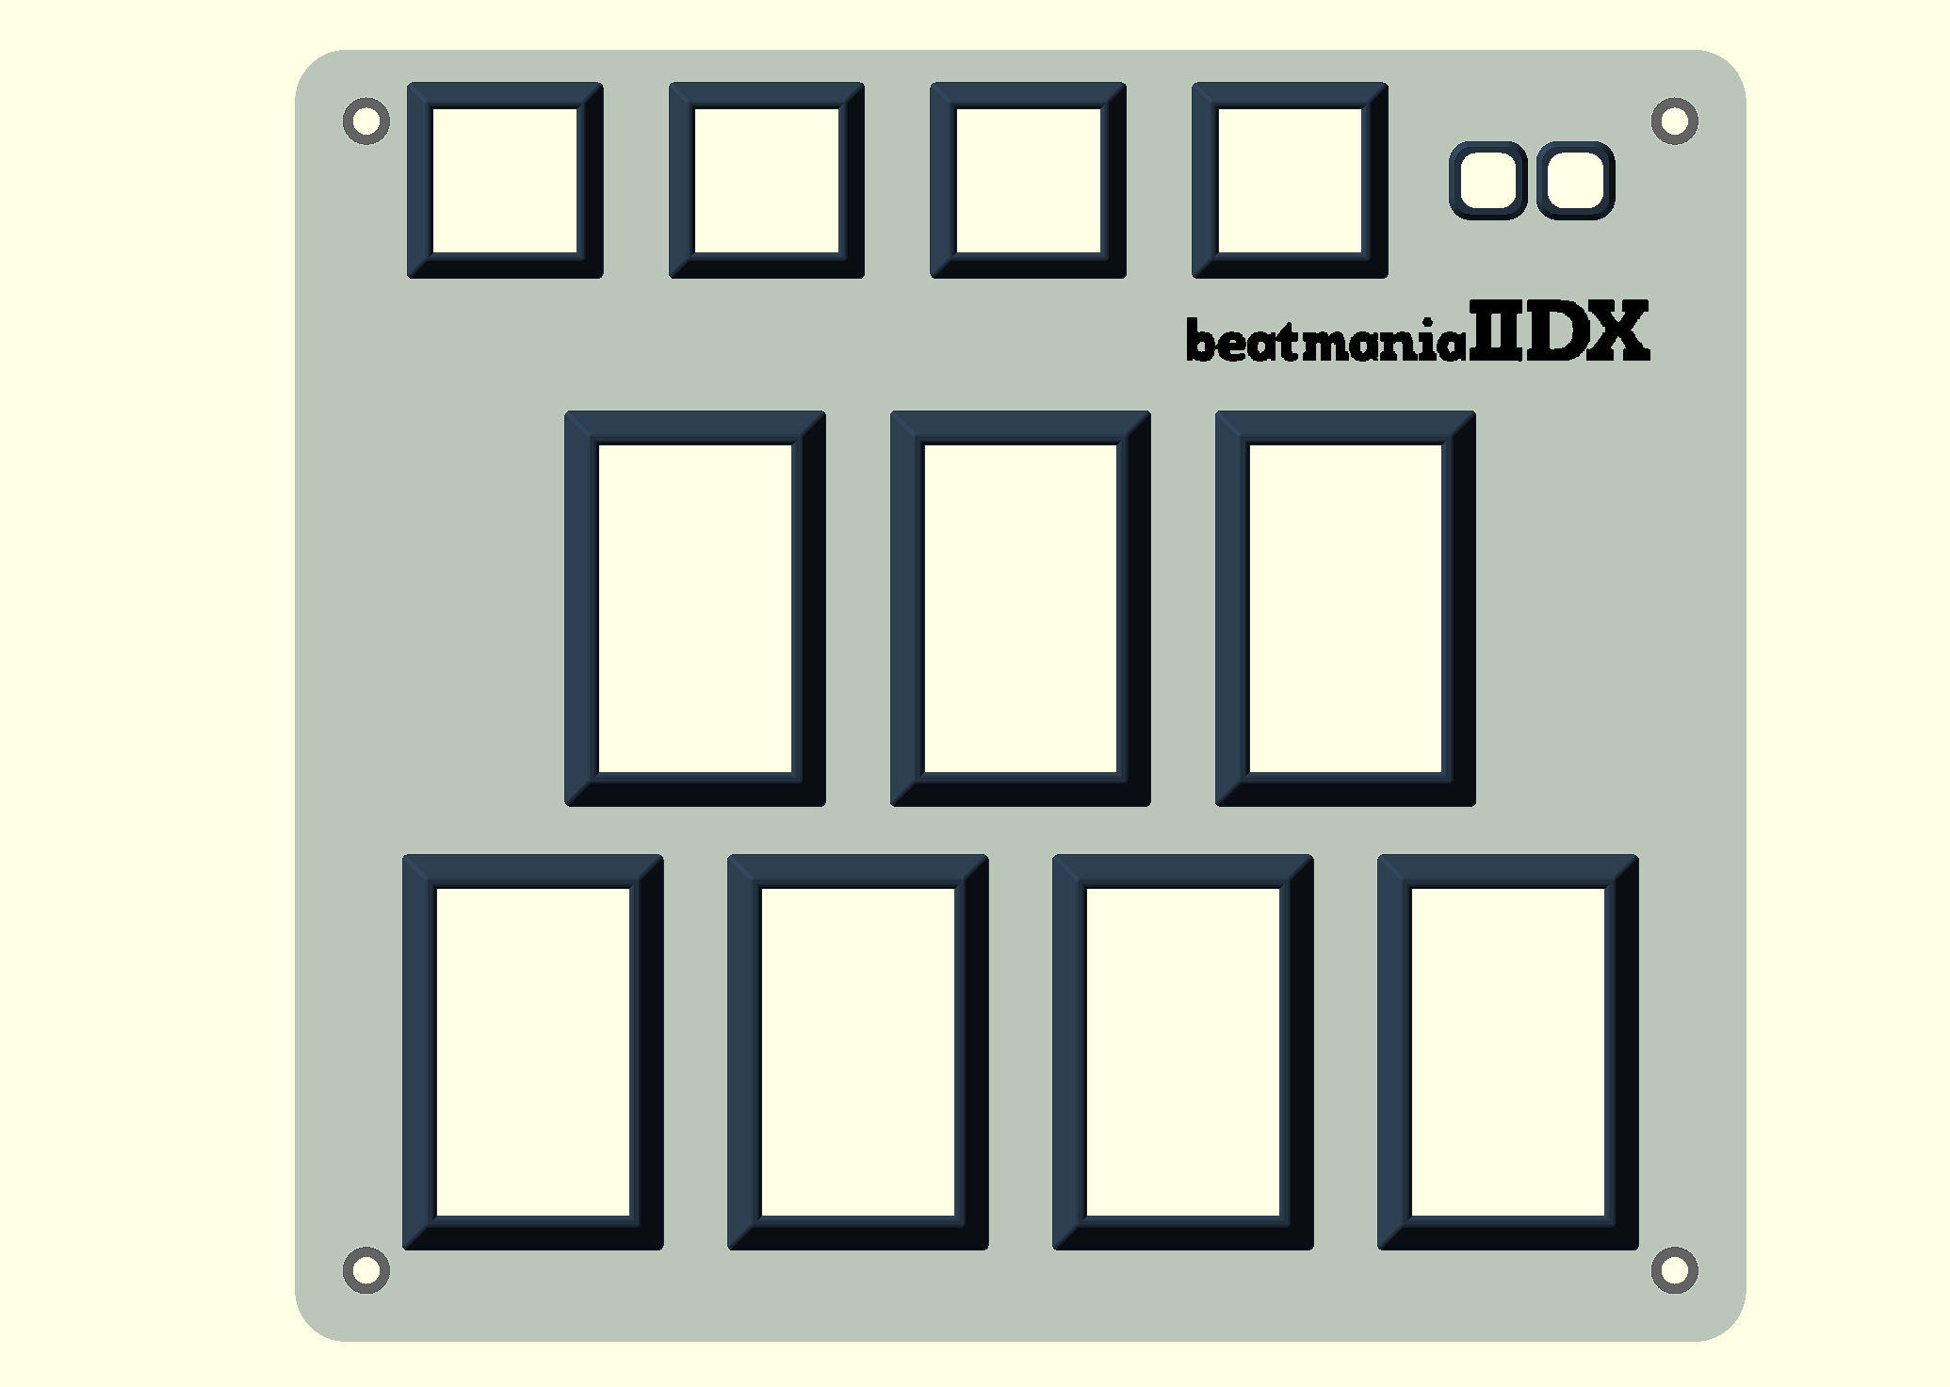
NORMAL MODE
E1
E2
E3
E4
A1
A2
2
4
6
1
3
5
7

Slide 2
NORMAL MODE
MIXER Mode
Hold
5 seconds
SETUP Mode

Slide 3
SETUP MODE
First
LED
Last
LED
LED
Direction
Sensor
Mode
Analog
Analog Reversed
I2C
I2C Reversed
LED Select
OK
Cancel
1.4°
2.8°
4.2°
Analog
Deadzone

Slide 4
MIXER MODE
Channel Selection
Dial
OK
Cancel
1-7 Quick Set

